Slide 1


SWIGGY DATA ANALYSIS
SUBMITTED BY:
Manjunath Raikar

Slide 2
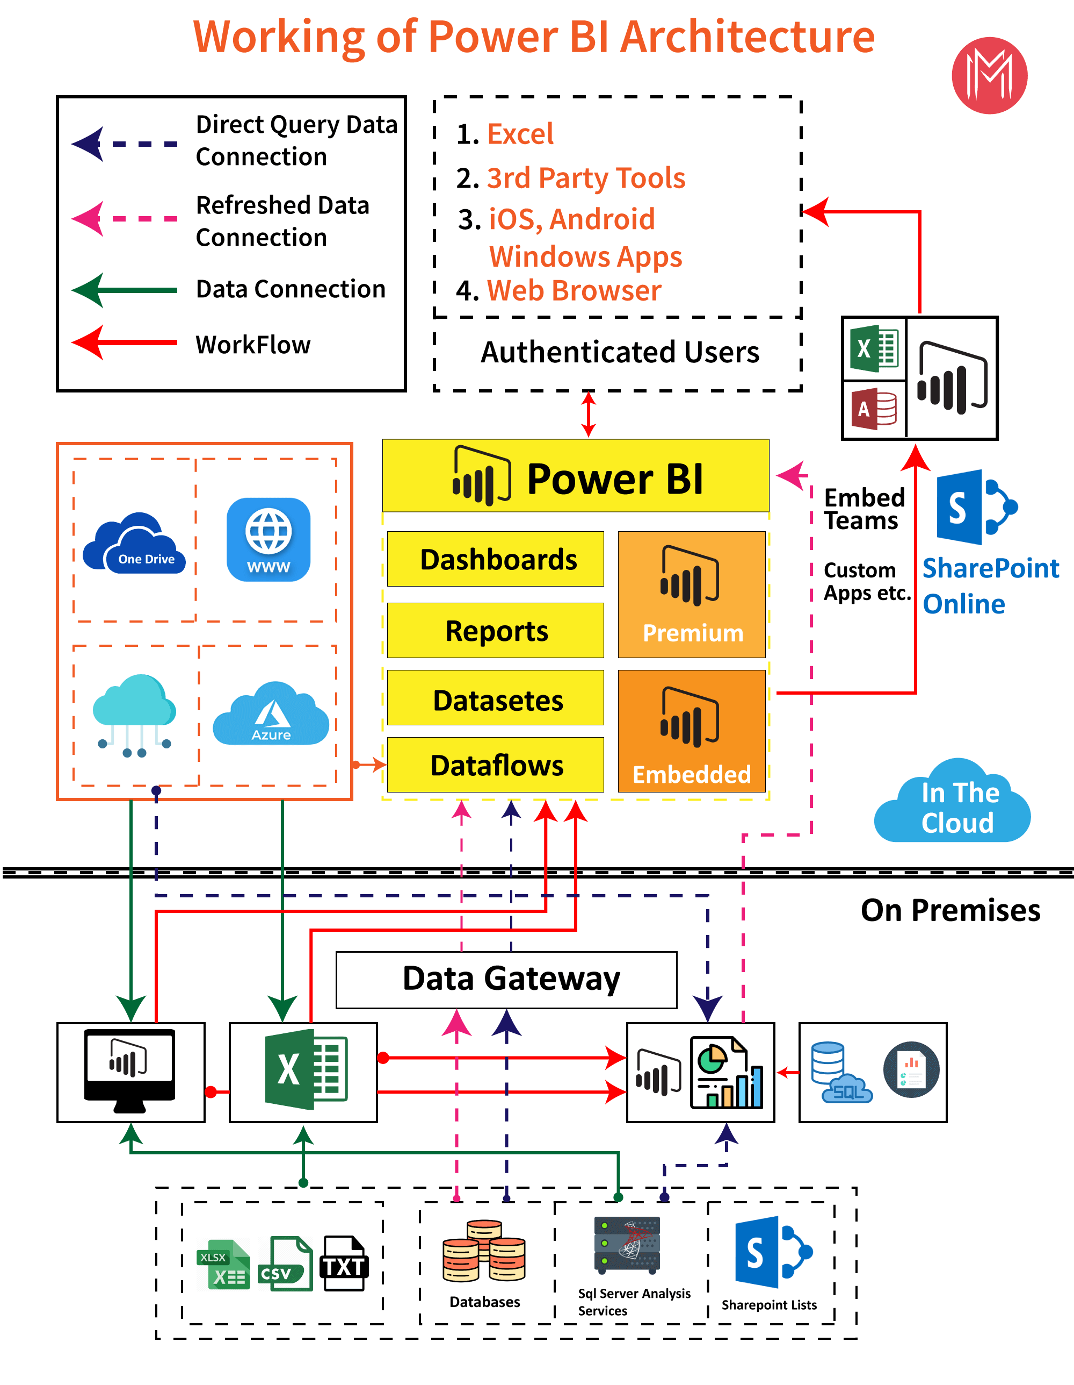
ARCHITECTURE

Slide 3
ETL OPERATIONS
Cleaning poorly formatted columns from the extracted raw data.
Skipping rows with Nan values.
Removing duplicated rows.
Changing the data types for necessary columns.

Slide 4
INSIGHTS

Slide 5
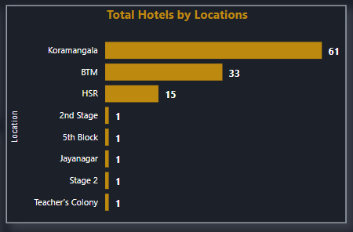
Locations with more number of shops are:
Koramangala - 63
BTM - 33
HSR - 15

Slide 6
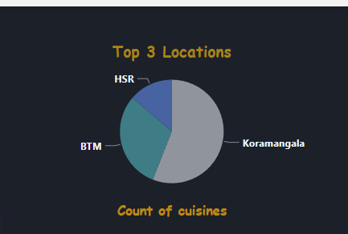
Koramangala location has more i.e, 53.39 % of availability of hotels

Slide 7
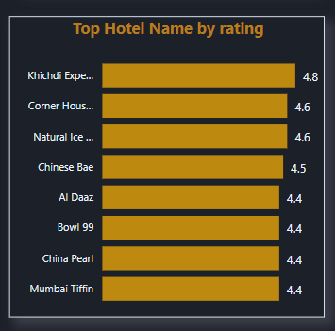
Khichdi Experiment has highest rating of 4.8 with a Price of 100/- per item.
Corner House Ice Cream and Natural Ice Cream are the shops with 4.6 rating, with the prices of 125/- and 75/-

Slide 8
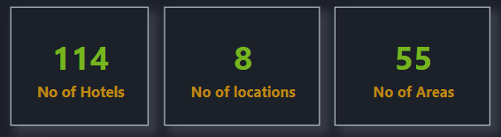
In Bangalore there are 114 Nos of Hotel,8 Nos of locations and 55 Nos of Areas

Slide 9
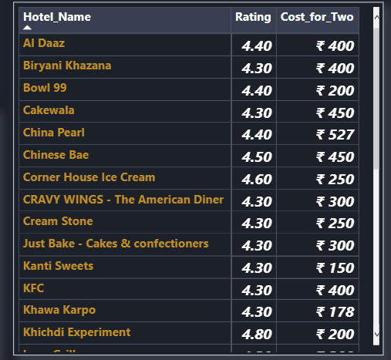
China hotel has highest price of 527/- among all the hotels in Bangalore
99 Variety Dosa & Tandoori Merchant hotels has least price of 50/- among all the hotels in Bangalore

Slide 10
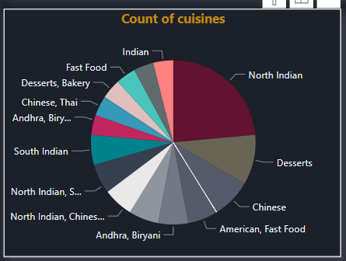
Only North Indian Cusine is mostly available in 12+ shops in Banglore and second top cuisine is Desserts and third is Chinses cuisine

Slide 11
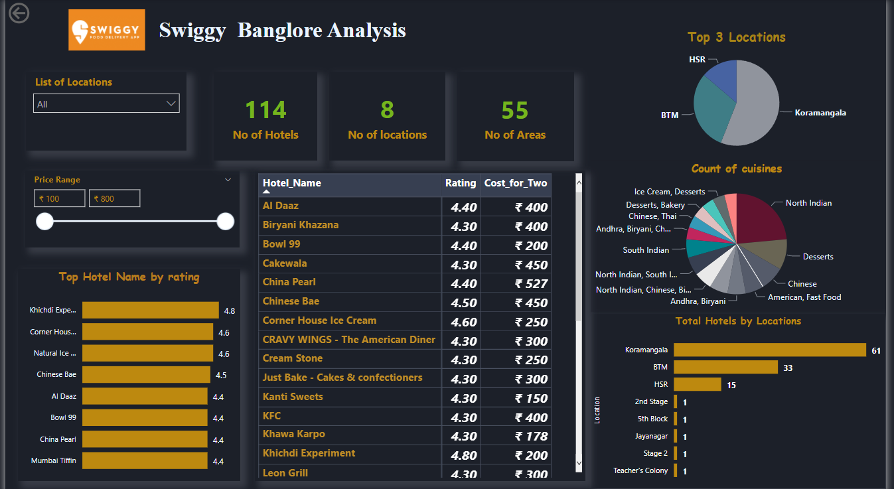
Final Dashboard

Slide 12
Conclusion:
Koramangala area has more number of shops with a total of 63 shops.
'BTM' location is 2nd with 33 shops, followed by 'HSR' with 15 shops.
Khichdi Experiment shop has highest rating of 4.8 and has a best price of 200 Rupees , it is located in Koramangala.
Based on ratings, top 10 shops are located in BTM,HSR & Koramangala.
Only North Indian Cuisine is mostly available in 12+ shops

Slide 13
Q & A
What's the Source of the Data - Collected from Given Data Set
Which tools you are used in this entire project – Power Bi
How did you deploy the report - The report was deployed in my Power BI Public Server
What was the type of Data - Numerical and Categorical Values

Slide 14
THANK YOU

